Slide 1
Public School District Reporting
Programs Operated for Students with Disabilities
New York State Education Department
Rate Setting Unit

Slide 2
District Operated Programs Reported in the ST-3 Special Aid Fund
Data is collected and Tuition Rates are set for Students with Disabilities under the following sections of the Education Law:
Section 4408 (School Age – July/August Summer programs)
Section 4410 (Preschool – 12 month programs)
Does not include School Year (10 month) School Age Special Education.
Tuition Rates are set from data reported on the ST-3 Supplemental Schedules - SS-10 through SS-16.

Slide 3
Where Can We Get Those Schedules From?

Slide 4
Data Collection
Supplemental Schedules (SS-10 – SS-16) are included toward the end of the ST-3 which is available from the State Aid Website. The schedules appear within the State Aid Management System (SAMS) which is completed annually by all districts.
Program/Business offices should ensure that the SS-10–SS-16 and the Special Aid Fund Schedule B3 are completed for all section 4408 (school age–summer) and section 4410 (preschool–12 month) programs.

Slide 5
Schedule B3 – Special Aid Fund
Report Expenditures in total for all:
Chapter 428 – Early Intervention (0-2) Programs (Account F2251) on lines 77 – 87.
Section 4410 – Preschool – 12 Month Programs (Account F2252) on lines 88-98.
Section 4408 – School Age – July/August Programs (Account F2253) on lines 99-109.
Expenditures are broken out in more detail on Supplemental Schedules (SS10-SS16) with a separate set of schedules or pages for each approved program.

Slide 6
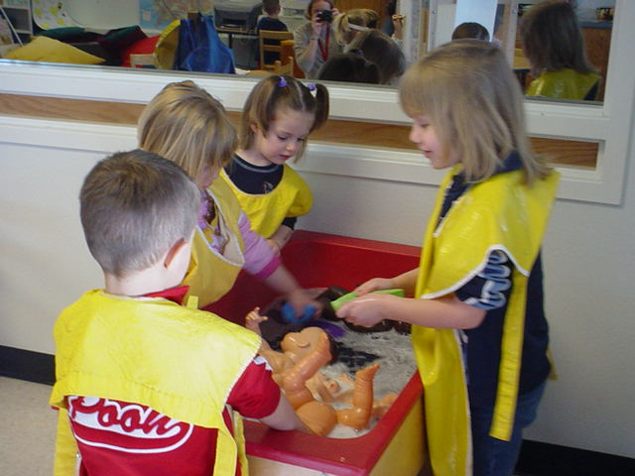
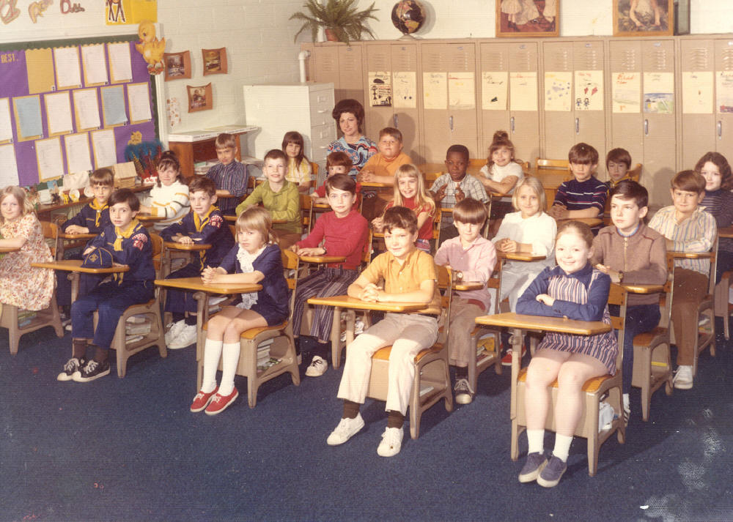
What Programs Do We Report on The SS10-SS16?

Slide 7
Cost data for Supplemental Schedules SS-10 through SS-16 must be completed for each of the following types of preschool programs that your school district operates:
PROGRAM PRESCHOOL (July-June)
9100-9109 – Preschool Special Class – over 2.5 hrs per day
9115-9119 - Preschool Special Class – 2.5 hours per day
9135 - 9149 – Preschool Special Education Itinerant Services –SEIS - (aka SEIT)
9160-9163–Presch. Integrated Spec Class–over 2.5 hrs/day
9164 – Day Care Costs in excess of the Integrated Program
9165-9169 - Preschool Integrated Spec. Class – 2.5 hrs/day
9190-9194 – Preschool Evaluations
9200 – Preschool Related Services

Slide 8
Cost data for Supplemental Schedules SS-10 through SS-16 must be completed for each of the following types of school age programs that your school district operates:
PROGRAM SCHOOL AGE (July-August)
9000-9009 – School Age Regular Special Education
9010-9014 - School Age Half Day Regular Special Education
Note – Program 9015 – School Age – Non Special Class
Were previously reported separately under:
9015 -Related Services Only, 9022 – Home Instruction, 9025 – Related Services with Specialized Instructions and 9029 – Specialized Instruction.
These have been consolidated under code 9015 and are reimbursed directly through the STAC unit as Regional Rates per unit of service.

Slide 9
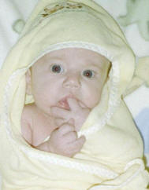
Cost data for Supplemental Schedules SS-10 through SS-16 must be completed for each of the following types of infant and/or miscellaneous programs that your school district operates:
PROGRAM INFANT/MISCELLANEOUS (July-June)
Infant/Toddler:
9300 – Infant/Toddler –
All Program Types
Miscellaneous:
9230 - School Age/Preschool 1:1 Aides for all students with 1:1 Aides on their IEP

Slide 10
SS10 - Revenues and Administrative Expenditures
Top Half of Schedule – Revenues
Report revenue received on appropriate line
0-2 Infant Revenue on DOH – Chapter 428 line
School Age Revenue on Section 4408 – School District Tuition line
Preschool Revenue on NYSED – Section 4410 – Preschool Tuition line
Revenue received should be the Certified Tuition Rate x FTE students enrolled in approved program.

Slide 11
SS10 - Revenues and Administrative Expenditures
Bottom Half of Schedule – Administrative Expenditures
Report administrative expenditures relating to district operated programs included in the ST-3 Special Aid Fund account codes F2251, F2252 or F2253.
Examples of costs include:
Salaries-Job Codes 500-590 – Program Administrative Salary total for program (Salary breakdown by individual job codes is detailed on SS-13) PDF Version
Salaries-Job Codes 600-690 – Agency Administrative Salary total for program (Salary breakdown by individual job codes is detailed on SS-13) PDF Version
Repairs and Maintenance – cost to maintain or restore Administrative assets.
Fringe Benefits – fringe benefits associated with salaries reported above are reported on appropriate fringe line.

Slide 12
SS11 – Direct Care and Facility Expenditures
Top half of Schedule – Direct Care Expenditures
Salaries – Job Codes 200- 390 – Direct Care Salary total for program (Salary breakdown by individual job codes is detailed on SS-13) PDF Version
Repairs and Maintenance – cost to restore and maintain assets
Travel and transportation – expenditures for field trips and/or transporting students from one facility to another. Do not report expenses for transporting students to and from home, these are reimbursed elsewhere.
Contracted Services – report direct care contracted services
Fringe Benefits - fringe benefits associated with salaries above.
Other Expenditures Reported in Special Aid Fund – costs allocated to program that are not reported within Special Aid Fund accounts F2251, F2252 or F2253 (anything reported is detailed on SS-16)

Slide 13
SS11 – Direct Care and Facility Expenditures
Bottom half of Schedule – Facility Expenditures
Salaries – Job Codes 100 - 190 – Facility Salary total for program (Salary breakdown by individual job codes is detailed on SS-13) PDF Version
Repairs and Maintenance – cost to restore and maintain facility assets
Contracted Services – report facility contracted services
Fringe Benefits - fringe benefits associated with salaries reported above.
Total Administrative, Direct Care and Facility Expenditures – total of all expenditures reported on the
SS-10 and SS-11 for this program.

Slide 14
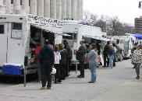
Ready For A Break Yet?

Slide 15
SS-12 – Expenditures in Other Districts
Expenditures your school district incurs to educate students with disabilities who are enrolled in Early Intervention, Preschool and School Age July/August programs outside of your district.
for example - BOCES, Other Districts, etc.
These totals should reconcile to Schedule B3 lines for Tuition Paid to Public Districts and Tuition – All Other for the appropriate section.

Slide 16
SS-13 – Personal Services by FTE and Job Code
Details by program the positions and salary amounts that are reported on SS-10 and/or SS-11.
Aggregate staff within each program that have the same position title and standard work week. Do not list individual staff.
Indicate total hours paid, FTE and amount paid for each position within the program
Agency Administrative staff are reported in total for all programs using program code 9999.
Totals reported by program must reconcile back to salary lines on SS-10 and SS-11.
Complete List of Position Title Codes – PDF Version

Slide 17
SS-13 – Personal Services by FTE and Job Code
The employee FTE is automatically
calculated using the following formula:
Total Hours Employees Actually Paid
Employees Standard Work Week x 52
Example: Teacher is paid for 6 wks. between July 1 and August 31. Teacher has worked 20 hours per week.
120 (20 x 6)
1950 (37.5 x 52) = .06 FTE
FTE Rule of Thumb:
2 month (6 week) = .12 FTE,
10 month (40 week) = .77 FTE
12 month (46 week) = .88 FTE

Slide 18
SS-14 – Student FTE of Enrollment
A separate page is completed for each program’s summer (2 month) and school year (10 month) enrollment. School age programs should only complete 2 month (summer) enrollment.
FTE of Enrollment by Funding Source
Report FTE enrollment on appropriate line
DOH – Chapter 428 – Infant – 0-2 year old
Section 4408 – Article 89 – School Age July/August
Section 4410 – Preschool 3 & 4 year old

Slide 19
SS-14 – Student FTE of Enrollment
FTE of Enrollment by Funding Source(con’t)
A student is considered to be enrolled for reimbursement purposes until the student is discharged.
Students admitted after the school year or discharged before the end of the school year should be prorated based upon weeks enrolled.
Students in programs operating less than 5 hours per day should be prorated based upon a five hour day.
See 175.6 of Commissioner’s Regulations for student enrollment regulations.

Slide 20
SS-14 – Student FTE of Enrollment
Number of Days in Session should be the number of days in the full time program during the July/August or September-June session.
Total Care Days is the calculated total of the Total FTE of Enrollment by Funding Source line multiplied by the Number of Days in Session line.
Number of One-Half Hour Sessions – For 9135 – 9149 (SEIS) programs enter the total direct and indirect ½ hour sessions provided.

Slide 21
SS-14 – Student FTE of Enrollment
FTE of Enrollment by Classroom
Enter the approved classroom ratio from your SED approval letter of students to teachers to teacher aides.
Enter the number of classrooms operated at the ratio reported above.
Enter the full-time equivalent student enrollment for the number of classrooms listed above.
Repeat the above for all approved classroom ratios operated.
Total Student FTE of all classroom ratios operated should reconcile to total FTE Enrollment by
Funding Source.

Slide 22
Schedule SS-15
No
Longer
Exists
(no we can’t make them all disappear – Sorry!)

Slide 23
SS-16 – Detail of Admin, Direct Care and Facility Costs
Schedule only needs to be completed on a program code basis for the programs’ expenditures that are reported in a Special Aid Fund other than the appropriate Special Aid Fund account Preschool F2252 or School Age F2253.
Expenditures reported on this schedule should reconcile to amounts reported on the “Other Expenditures Reported in the Special Aid Fund” lines on the SS-10 and/or SS-11.
Enter the Special Aid Fund account code in which the expenditure is reported in the ST-3 Acct Code column.

Slide 24
Related Service Schedules
Required on a yearly basis for all School Age Regular Special Education (9000-9014) programs (for 2 month piece only) and all Preschool (July-June) programs reported with the exception of program 9135 –SEIS (which has no related services).
Based upon IEP Mandated Related Services
SED-4(RS-1) – Related Service Capacity, Need and Productivity must be submitted or tuition rate(s) will not be set.
FTE in column 2a must reconcile to FTE’s reported on SS-13 -
RS-2 – Need for Related Services – not submitted to RSU , held as backup by school.
Related Service Schedules and Instructions –

Slide 25
Common Reporting Errors
Schedule B3 completed but SS10-SS16 not completed.
SS10-SS16 completed but Special Aid Fund–Schedule B3 not completed (most likely leaving disabled program costs in the General Fund).
Total Expenditures reported for all SS10-SS16 programs do not reconcile to total expenditures reported on Schedule B3.
Programs not broken out on separate set of SS10-SS16 pages for each program requiring a tuition rate.
All approved programs requiring a Tuition Rate are not reported.
Programs reported that are not approved.
Costs reported using cents. Use whole dollars only.

Slide 26
Common Reporting Errors – Con’t
Salary lines on SS-10 and SS-11 do not reconcile to salaries detailed by program on Schedule SS-13.
SS-13 Salaries are listed by individuals and are not aggregated by staff within a program with the same position title and standard work week.
SS-13 FTE not calculated using FTE formula.
SS-14 Enrollment not prorated for students attending less than full day or less than full # of weeks program operated.
Related Service Schedules (SED-4 and RS-2) are not completed for required programs.
Direct Care Related Service FTE’s reported on the SS-13 do not reconcile to the FTE’s reported on the SED-4 in column 2a.
1:1 Aides are not reported under program 9230.

Slide 27
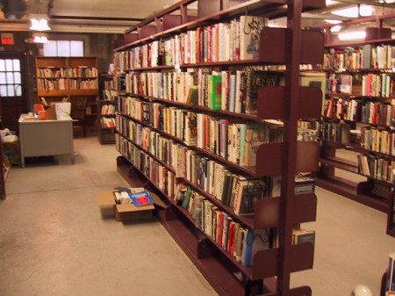
Where Can I Learn More?

Slide 28
Other Resources
Tuition Rate Setting Methodology Letters – separate memorandum each year outlining parameters of rate-setting process.
Reimbursable Cost Manual – separate manual each year outlining reimbursable costs considered necessary and reasonable in calculating tuition rates.

Slide 29
Electronic Notification of Approved Tuition Rates
Districts will be able to review and print tuition rates and other pertinent data over the Internet,via the State Education Department Financial Information Network (SEDFIN).
See Crosswalk from Supplemental Schedules to SEDFIN TCALC Screen -
Users must register via the Rate-Setting website to receive a user code and password to access the system.
Registration section of rate-setting web site

Slide 30
Need More Help?
Please don’t hesitate to call us.

Slide 31
Contact Information
Each district will be assigned an accountant in the rate-setting unit who will analyze the districts data submitted and set any tuition rates. This individual can also be contacted to assist the district with any questions throughout the rate-setting process.
Office contact information:
Address: Rm. 302 EB, Albany, NY 12234
Phone: (518) 474-3227
Website: http://www.oms.nysed.gov/rsu/
E-mail: rateweb@nysed.gov
See Employee Phone List

Slide 32
Thank You for viewing the slideshow.

